Slide 1
COMP1860 Building our Digital World: Computer Systems & Architecture
S1.W1.L1: Computer Architecture & History of Computing
Dr James Dyer

Slide 2
Learning Outcomes
Recognise the contributions of individuals and organisations in the computing field.
Explain trends in the history of the computing field.
Describe the basic building blocks of computers and their role in the historical development of computer architecture.

Slide 3
Text Book
This lecture is based on chapter 1 of Stallings. Computer Organisation & Architecture
  It covers sections 1.1, 1.2 and 1.3 up to Transistors

Slide 4
Overview
Architecture & Organisation
Computer Structure
History of Computer Hardware
Von Neumann Architecture

Slide 5
What is a computer?
A machine which can:
  Automatically carry out sequences of arithmetic or logical operations
  Can be programmed to do so

Slide 6
Architecture & Organisation

Slide 7
Architecture
Architecture
  Logical design of the computer
  Defines the attributes of a system visible to the programmer
    Instruction set
    number of bits used to represent various data types
    I/O mechanisms
    techniques for addressing memory
  Have a direct impact on the logical execution of a program
  e.g., is there a multiply instruction?
Notes:
In describing computers, a distinction is often made between computer architecture and computer organization.
Computer architecture refers to those attributes of a system visible to a programmer or, put another way, those attributes that have a direct impact on
the logical execution of a program. A term that is often used interchangeably with computer architecture is instruction set architecture (ISA) . The ISA defines instruction formats, instruction opcodes, registers, instruction and data memory; the effect of executed instructions on the registers and memory; and an algorithm for controlling instruction execution.
Computer organization refers to the operational units and their interconnections that realize the architectural specifications. Examples of architectural attributes include the instruction set, the number of bits used to represent various data types (e.g., numbers, characters), I/O mechanisms,
and techniques for addressing memory. Organizational attributes include those hardware details transparent to the programmer, such as control signals; interfaces between the computer and peripherals; and the memory technology used.
For example, it is an architectural design issue whether a computer will have a multiply instruction. It is an organizational issue whether that instruction will
be implemented by a special multiply unit or by a mechanism that makes repeated use of the add unit of the system. The organizational decision may be based on the anticipated frequency of use of the multiply instruction, the relative speed of the two approaches, and the cost and physical size of a special multiply unit.
Historically, and still today, the distinction between architecture and organization has been an important one. Many computer manufacturers offer a family of
computer models, all with the same architecture but with differences in organization. Consequently, the different models in the family have different price and performance characteristics. Furthermore, a particular architecture may span many years and encompass a number of different computer models, its organization changing with changing technology.

Slide 8
Organisation
Organisation
  Physical implementation of the architecture
  Control signals, interfaces between the computer and peripherals, memory technology used
  How components are built using electronics
  How components are arranged and connected in a chip or on a circuit board
  e.g., is there a hardware multiply unit or is it done by repeated addition?

Slide 9
Architecture & Organisation
Companies typically design families of computers which share the same basic architecture,
  e.g. Intel x86, ARM64
This gives code compatibility.
  At least in a backwards sense (i.e. backwards compatibility).
  Organisation differs between different versions.

Slide 10
Computer Structure

Slide 11
Structure and Function
Structure
  This is the way in which components relate to each other.
Function
  This is the operation of individual components as part of the structure.
Notes:
A computer is a complex system; contemporary computers contain millions of elementary electronic components. How, then, can one clearly describe them?
The key is to recognize the hierarchical nature of most complex systems, including the computer. A hierarchical system is a set of interrelated subsystems, each of the latter, in turn, hierarchical in structure until we reach some lowest level of elementary subsystem.
The hierarchical nature of complex systems is essential to both their design and their description. The designer need only deal with a particular level of the
system at a time. At each level, the system consists of a set of components and their interrelationships. The behavior at each level depends only on a simplified,
abstracted characterization of the system at the next lower level. At each level, the designer is concerned with structure and function:
• Structure: The way in which the components are interrelated.
• Function: The operation of each individual component as part of the structure.
In terms of description, we have two choices: starting at the bottom and building up to a complete description, or beginning with a top view and decomposing the system into its subparts. Evidence from a number of fields suggests that the top-down approach is the clearest and most effective.

Slide 12
Function
There are four basic functions that a computer can perform:
Data processing
  Data may take a wide variety of forms, and the range of processing requirements is broad
Data storage
  Short-term
  Long-term
Notes:
Both the structure and functioning of a computer are, in essence, simple. In general terms, there are only four basic functions that a computer can perform:
Data Processing. The data may take a wide variety of forms, and the range of processing requirements is broad. However, we
shall see that there are only a few fundamental methods or types of data processing.
Data Storage. Even if the computer is processing data on the fly (i.e., data come in and get processed, and the results go out
immediately), the computer must temporarily store at least those pieces of data that are being worked on at any given moment. Thus, there is at least a short-term data storage function. Equally important, the computer performs a long-term data storage function. Files of data are stored on the computer for subsequent retrieval and update.
Data Movement. The computer’s operating environment consists of devices that serve as either sources or destinations of data. When data are received from or delivered to a device that is directly connected to the computer, the process is known as input–output (I/O), and the device is referred to as a peripheral. When data are moved over longer distances, to or from a remote device, the process is known as data communications.
Control. Within the computer, a control unit manages the computer’s resources and orchestrates the performance of its functional parts in response to those instructions.

Slide 13
Function
Data movement
  Input-output (I/O) - when data are received from or delivered to a device (peripheral) that is directly connected to the computer
  Data communications – when data are moved over longer distances, to or from a remote device
Control
  A control unit manages the computer’s resources and orchestrates the performance of its functional parts in response to instructions

Slide 14
Hierarchical Structure
A computer is a very complex system which is difficult to describe (e.g. x86 manual ∼ 5000 pages).
This is simplified by considering a hierarchical structure.
At each level, the system consists of a set of components and their interrelationships.
The behaviour at each level depends on a simplified, abstracted characterisation of the system at the next level down.

Slide 15
Hierarchical Structure
Figure 1.1 provides a hierarchical view
of the internal structure of a traditional single-processor computer.
Source: Stallings. Computer Organisation & Architecture. p.27

Slide 16
Computer Components
CPU
  Controls the operation of the hardware
  Interprets and executes instructions from hardware and software
Main Memory
  Stores data and program instructions
Input/Output
  Hardware that allows machine to interact with users and other devices
  Display, keyboard, printer, network interface card
  Captures input signal as data
  Converts output data to signal hardware understands
System Bus
  Connects CPU, main memory and I/O
Co-processors
  Some operations have specialised co-processors
    E.g., graphic processing unit (GPU) handles calculations and output related to graphical display
    E.g. cryptoprocessor handles calculations related to cryptography

Slide 17
CPU components
Control Unit
  Controls the operation of the CPU and hence the computer
Arithmetic and Logic Unit (ALU)
  Performs the computer’s data processing function
Registers
  Provide storage internal to the CPU
CPU Interconnection
  Some mechanism that provides for communication among the control unit, ALU, and registers

Slide 18
Multicore components
Central processing unit (CPU)
  Portion of the computer that fetches and executes instructions
  Consists of an ALU, a control unit, and registers
  Referred to as a processor in a system with a single processing unit
Core
  An individual processing unit on a processor chip
  May be equivalent in functionality to a CPU on a single-CPU system
  Specialized processing units are also referred to as cores
Processor
  A physical piece of silicon containing one or more cores
  Is the computer component that interprets and executes instructions
  Referred to as a multicore processor if it contains multiple cores

Slide 19
Multicore
Structure
Figure 1.2 is a simplified view of the principal components of a typical multicore computer.
Source: Stallings. Computer Organisation & Architecture. p.29
Notes:
Figure 1.2 is a simplified view of the principal components of a typical multicore computer. Most computers, including embedded computers in smartphones
and tablets, plus personal computers, laptops, and workstations, are housed on a motherboard. Before describing this arrangement, we need to define some terms.
A printed circuit board (PCB) is a rigid, flat board that holds and interconnects chips and other electronic components. The board is made of layers, typically two to ten, that interconnect components via copper pathways that are etched into the board. The main printed circuit board (PCB) in a computer is called a system board or motherboard , while smaller ones that plug into the slots in the main board are
called expansion boards.
The most prominent elements on the motherboard are the chips. A chip is a single piece of semiconducting material, typically silicon, upon which electronic
circuits and logic gates are fabricated. The resulting product is referred to as an integrated circuit .
The motherboard contains a slot or socket for the processor chip, which typically contains multiple individual cores, in what is known as a multicore processor .
There are also slots for memory chips, I/O controller chips, and other key computer components. For desktop computers, expansion slots enable the inclusion of more components on expansion boards. Thus, a modern motherboard connects only a few individual chip components, with each chip containing from a few thousand up to hundreds of millions of transistors.
Figure 1.2 shows a processor chip that contains eight cores and an L3 cache. Not shown is the logic required to control operations between the cores and the
cache and between the cores and the external circuitry on the motherboard. The figure indicates that the L3 cache occupies two distinct portions of the chip surface. However, typically, all cores have access to the entire L3 cache via the aforementioned control circuits. The processor chip shown in Figure 1.2 does not represent any specific product, but provides a general idea of how such chips are laid out.
Next, we zoom in on the structure of a single core, which occupies a portion of the processor chip. In general terms, the functional elements of a core are:
■ Instruction logic: This includes the tasks involved in fetching instructions and decoding each instruction to determine the instruction operation and the
memory locations of any operands.
■ Arithmetic and logic unit (ALU): Performs the operation specified by an instruction.
■ Load/store logic: Manages the transfer of data to and from main memory via cache.
The core also contains an L1 cache, split between an instruction cache (I-cache) that is used for the transfer of instructions to and from main memory, and
an L1 data cache, for the transfer of operands and results. Typically, today’s processor chips also include an L2 cache as part of the core. In many cases, this cache is also split between instruction and data caches, although a combined, single L2
cache is also used.
Keep in mind that this representation of the layout of the core is only intended to give a general idea of internal core structure. In a given product, the functional
elements may not be laid out as the three distinct elements shown in Figure 1.2, especially if some or all of these functions are implemented as part of a microprogrammed control unit.

Slide 20
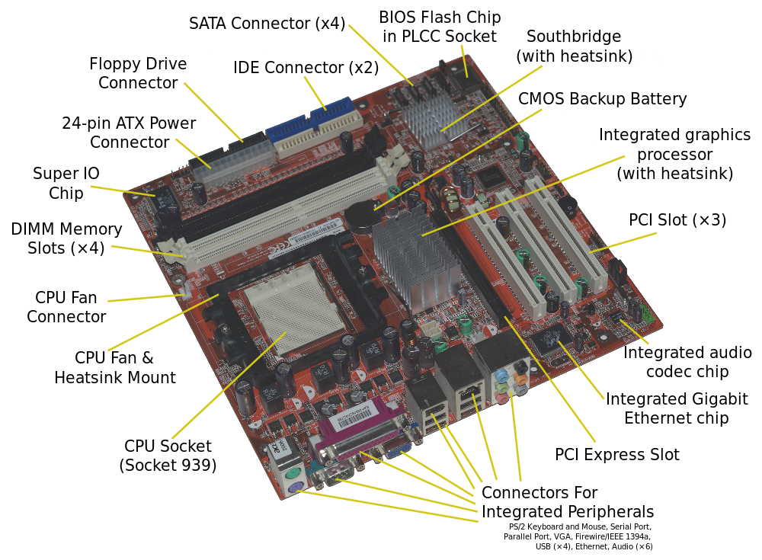
Motherboard

Slide 21
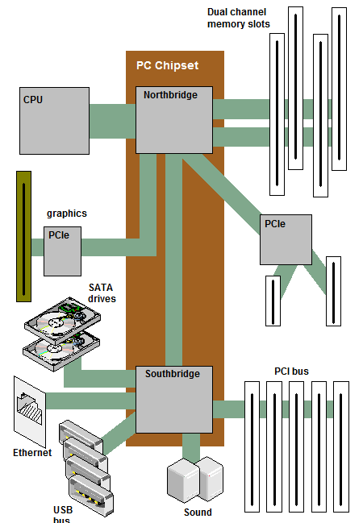
Modern PC Layout

Slide 22
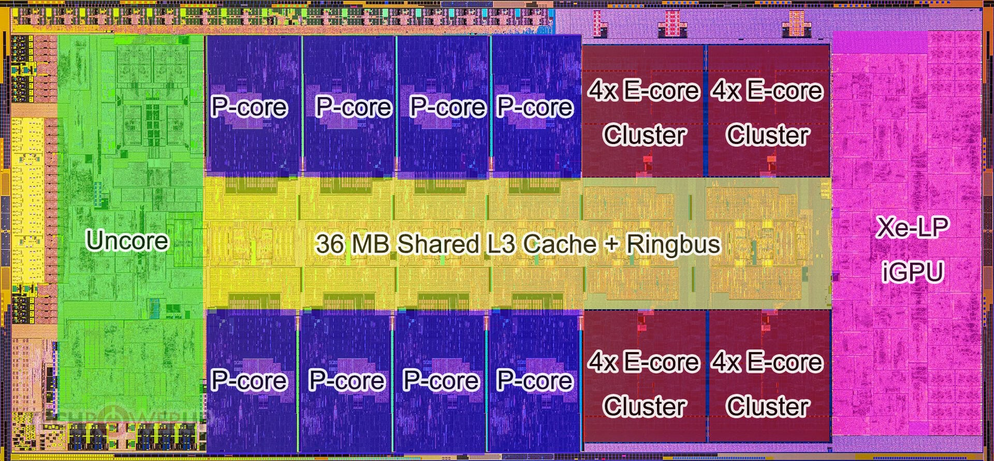
Multicore Processor (14th gen Intel Core)
Processor die (23.8 by 10.8 mm)

Slide 23
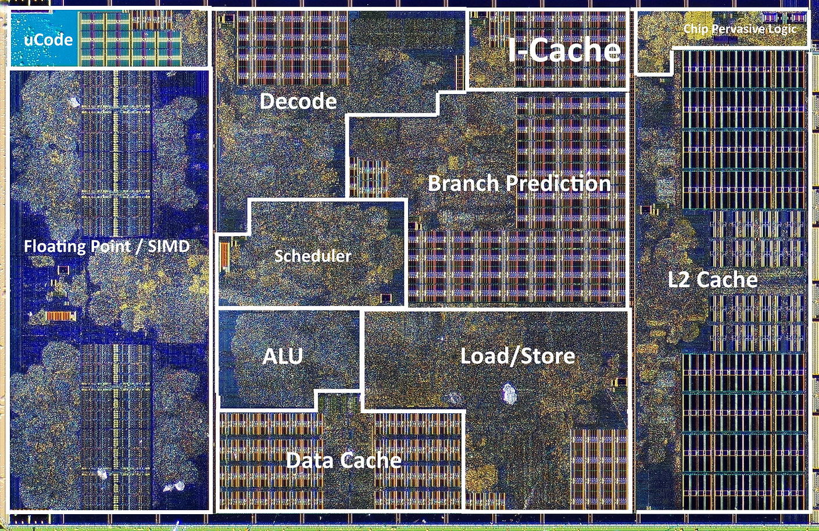
AMD Zen 2 Core

Slide 24
Break/Activity

Slide 25
History of Computer Hardware Part 1

Slide 26
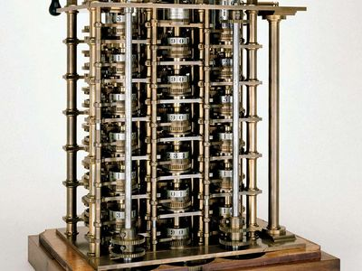
Development of Computers
1st computing devices mechanical
  Gears
  Decimal
  E.g. Babbage’s Analytical Engine
Source: Britannica.com

Slide 27
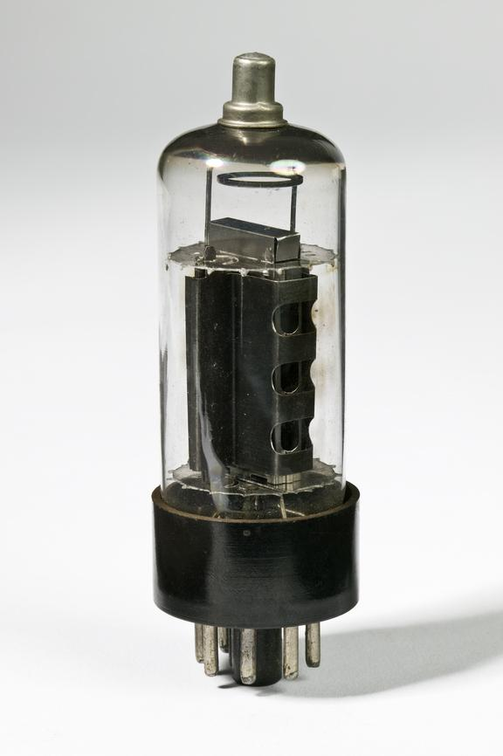
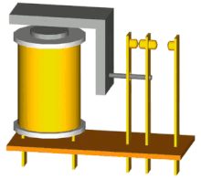
Development of Computers
In 1930s/1940s move to electrical & electronic switching devices
Electrical relays
Thermionic valve (electronic)

Slide 28
Why switches?
Switches have two states: open and closed
Easy to map logical states: true and false
Allows for Boolean logic to be performed
Binary arithmetic
Storage of data in binary form

Slide 29
First digital computers (1930s & 1940s)
Z3
  electrical
Colossus
  Electronic (valves)
  Used by Bletchley Park team
ENIAC
  Electronic (valves)
  Used to calculate simulations in Manhattan project

Slide 30
Stored Program Computer
Institute for Advanced Studies (IAS) machine
  Fundamental design approach was the stored program concept
  Attributed to the mathematician John von Neumann
  First publication of the idea was in 1945 for the EDVAC
  Design began at the Princeton Institute for Advanced Studies
  EDVAC completed in 1952
  Prototype of all subsequent general-purpose computers (von Neumann Architecture)
  Machine instructions stored as data (stored program) in memory or read in from I/O.

Slide 31
Von Neumann Architecture

Slide 32
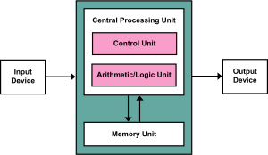
Von Neumann Architecture
The von Neumann machine is based on four linked components:
  Main memory which can store programs alongside data.
  An Arithmetic and Logic Unit (ALU) capable of operating on binary data.
  A control unit which interprets instructions in memory and executes them.
  Input and output equipment operated by the control unit.

Slide 33
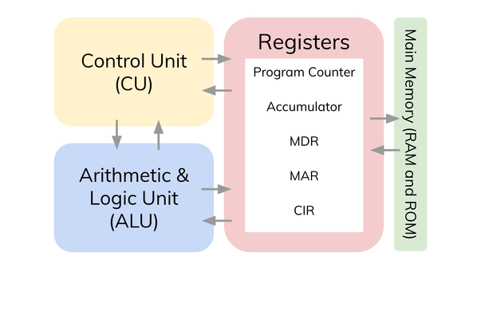
Registers
Memory address register (MAR)
  Specifies the address in memory of the word to be written from or read into the MBR
Memory data register (MDR)
  Contains a word to be stored in memory or sent to the I/O unit
  Or is used to receive a word from memory or from the I/O unit
Current Instruction register (CIR)
  Contains the opcode instruction being executed
Program counter (PC)
  Contains the address of the next instruction to be fetched from memory
Accumulator (AC)
  Employed to temporarily hold operands and results of ALU operations

Slide 34
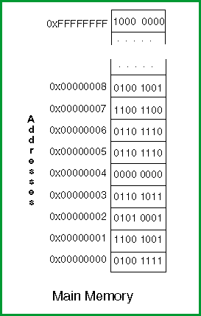
Addresses
Addresses are an index to locations in memory
Most modern computers are byte addressable
  Address is number used to refer to a specific byte in memory
  CPU sees memory as large linear sequence of bytes

Slide 35
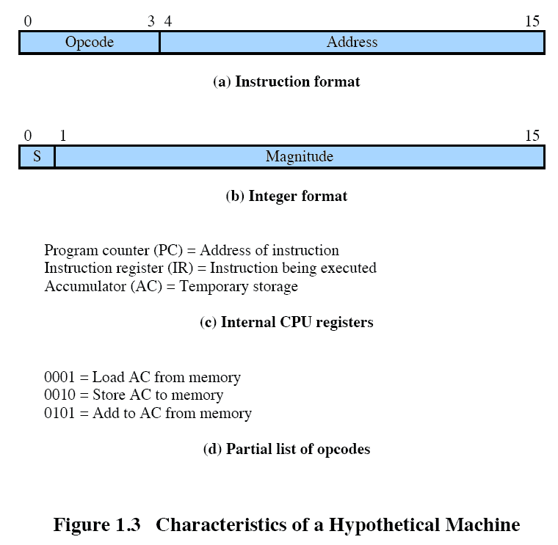
Instructions
Instruction consists of:
  Opcode – code for instruction to perform
  Operands – data to perform instruction or address to use
Instruction types:
  Data handling
    Set register
    Copy from memory
    Read and write to I/O
  Arithmetic and logic
  Control flow

Slide 36
Fetch-Decode-Execute Cycle
The processor fetches an instruction from memory into instruction register (IR)
Determines machine operation from opcode (decode)
Performs operation (execute)
Typically, the program counter (PC) holds the address of the next instruction to be fetched
  PC is incremented after each fetch

Slide 37
Von Neumann Bottleneck
Von Neumann architectures shares memory bus for data and program instructions
Single bus limits throughput (data transfer rate) between CPU and memory
CPU must wait for data to be moved to or from memory

Slide 38
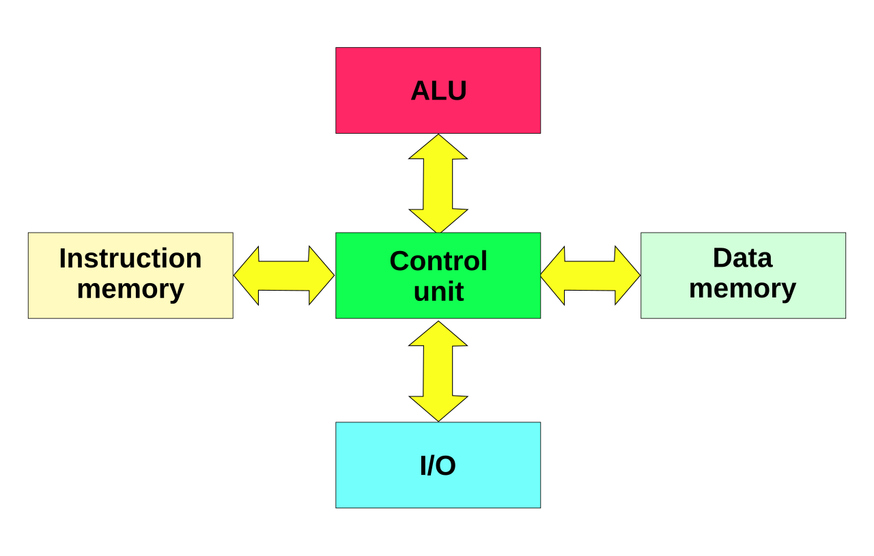
Harvard Architecture
Named for Harvard Mark 1 (1944)
Difference is two buses from memory to CPU
  Instructions
  Data
  Mark 1 could read in instructions and data from punch cards simultaneously
Advantages
  CPU receives instruction and data concurrently
Disadvantages
  Programs cannot be stored in same memory as data
Modern uses
  Microcontrollers
  Digital Signal Processors

Slide 39
Von Neumann Bottleneck Mitigations
Cache between the CPU and the main memory;
  Stores instructions and data for future operations
Separate caches or separate access paths for data and instructions (the so-called Modified Harvard architecture);
Using branch predictor algorithms and logic;
On-chip scratchpad memory to reduce memory access;
Implementing the CPU and the memory as a system on chip
  Reduces latency

Slide 40
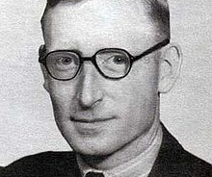
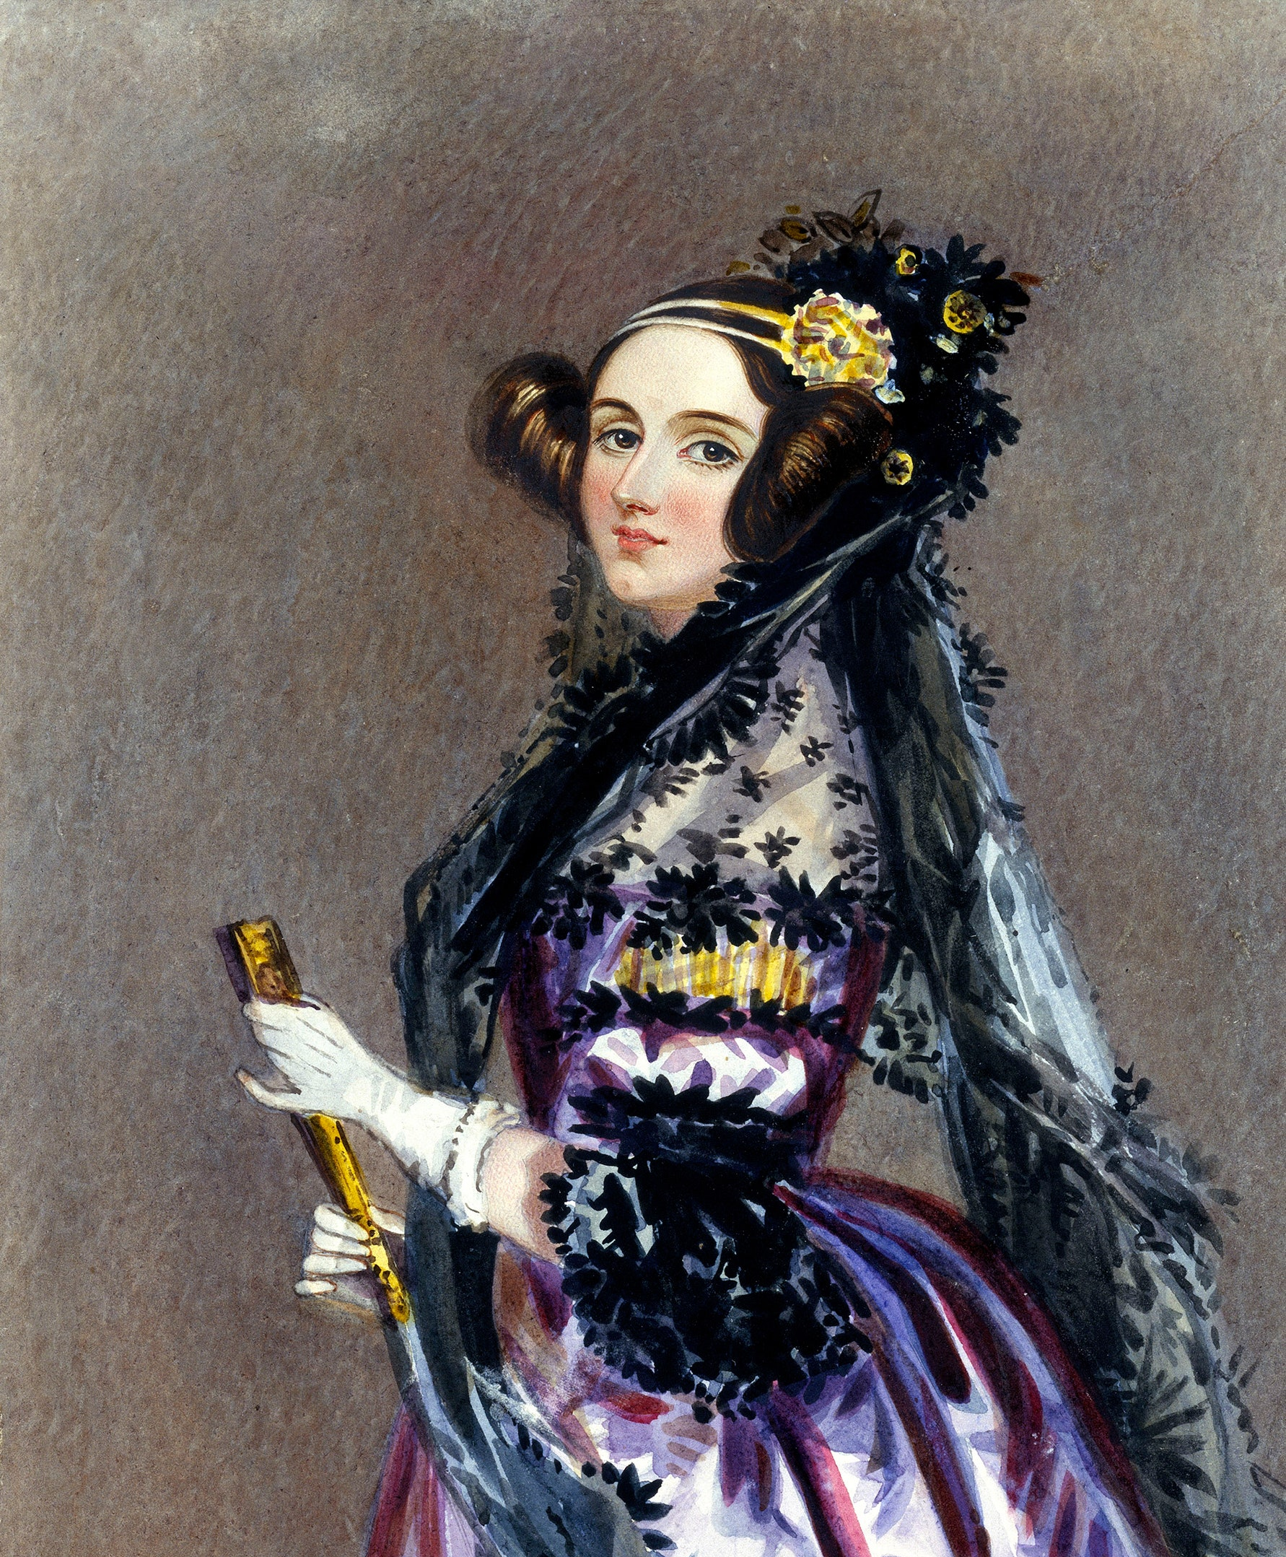
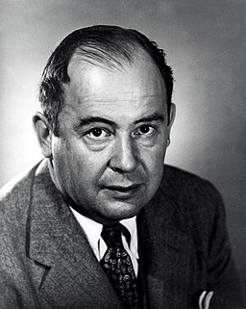
Activity
Identify each of the figures in the photos
Hint 1: The one on the left is someone we have talked a lot about in this lecture
Hint 2: The one on the right worked with someone mentioned at the start of the section on history of computer hardware
Hint 3: The one in the middle designed a famous UK computer used during WWII

Slide 41
Summary
Architecture & Organisation
Computer Structure
History of Computer Hardware
Von Neumann Architecture

